Slide 1
GitHub Automated Branch Protection Options
Nicholas Jolly

Slide 2
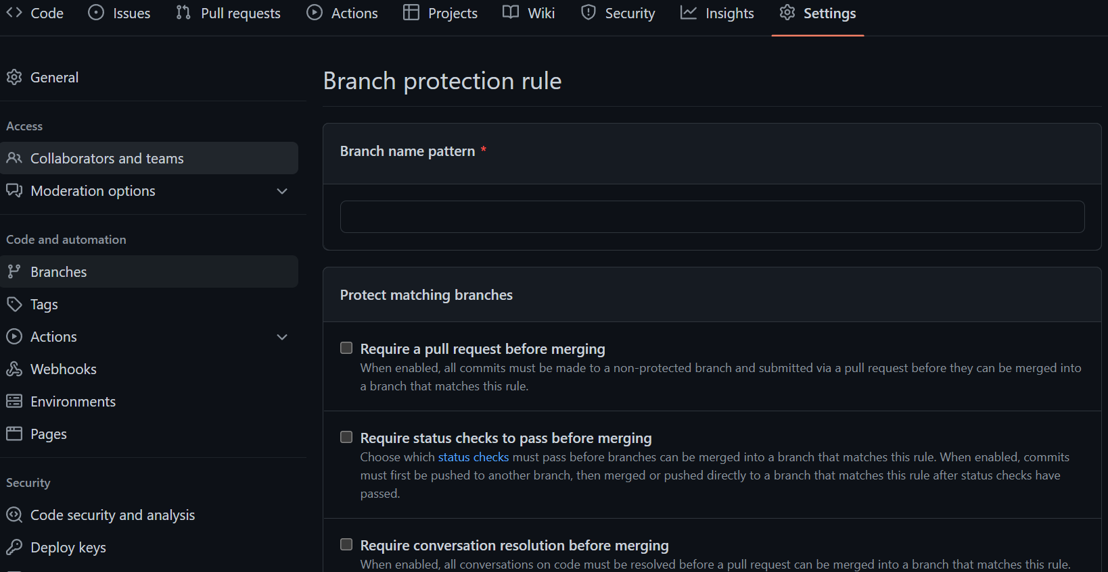
Branch Protection Rules in GitHub
Branch Settings > Branches > Branch Protection Rules > Add Rule
Here you can set default out-of-the-box requirements before merging, like requiring pull request reviews, signed commits and restricting who can push to the matching branch

Slide 3
Webhook Branch Protection and Notifications
Using Jenkins, we can automate notifications and other post-build settings. Setup guide:
Begin configuring a new Jenkins job in Jenkins
Add and configure webhook in the GitHub repo
Add your own build actions (like an email notification to the security team)
Test functionality of your automated build

Slide 4
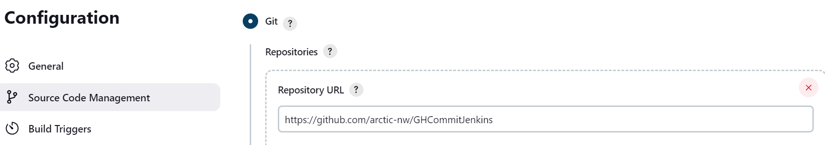
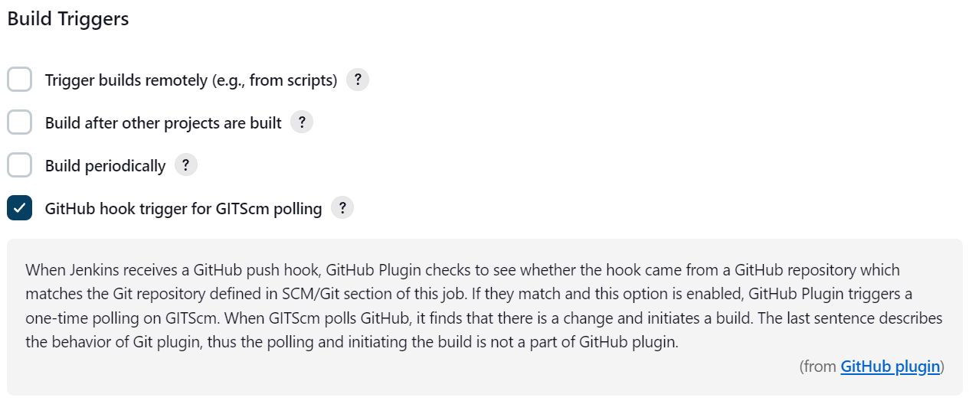
Begin configuring the new Jenkins job
Enter Repo URL
Select: GitHub hook trigger for GITScm polling

Slide 5
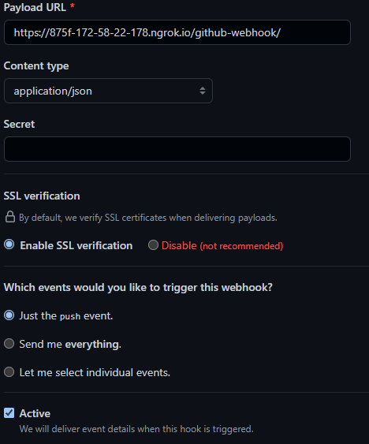
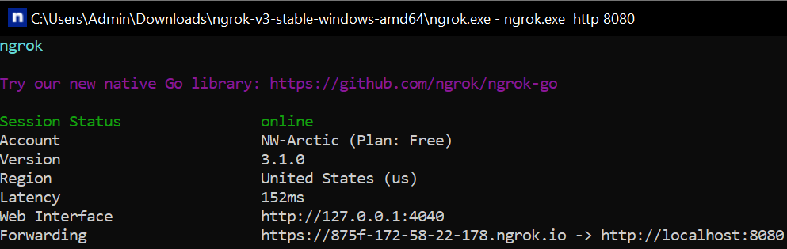
Add a webhook in GitHub
In GitHub repo > Settings > Webhooks. Configure triggers as desired (e.g. Just push events)
Open ngrok.exe and use command grok.exe http: 8080 to start forwarding
Copy forwarding URL and paste in payload URL with /github-webhook/

Slide 6
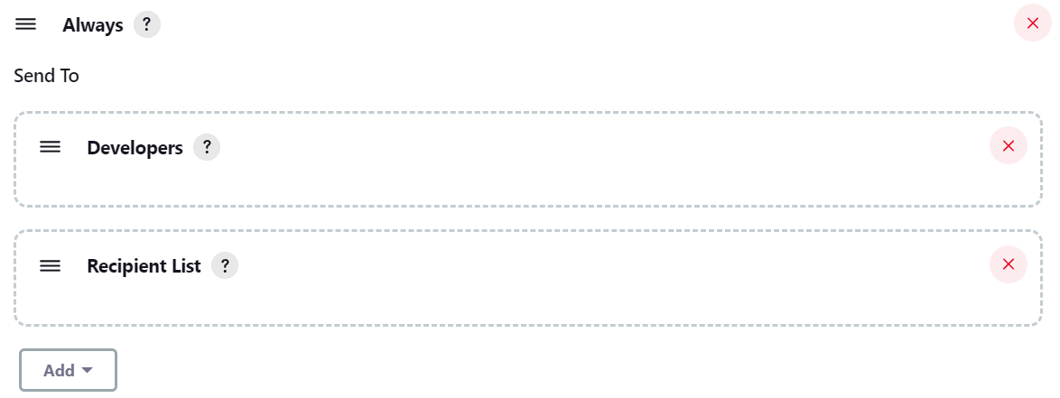
Add specific build actions
For one example, setup an email notification to the security team when triggering the Jenkins job

Slide 7
Test your build!
I can demo making an edit to README.txt on our repo to simulate a commit and see the Jenkins job operate.
github.com/arctic-nw/GHCommitJenkins
Begin Demo (if time permits)

Slide 8
Simplified Architectural Diagram
Github Branch Protection Rules
Webhook Trigger POST Request
Action: Commit by a Dev
Github Repo
Build Actions (notifications, logs, etc.)
Trigger Jenkins Job
Branch Protection Focus

